Slide 1
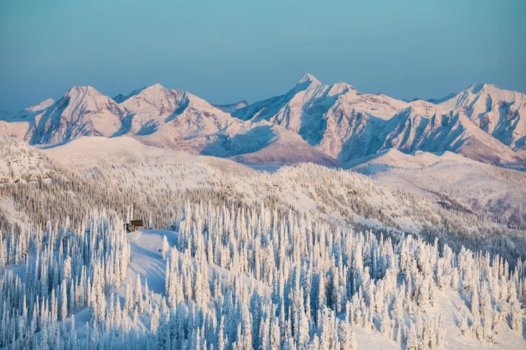
Big Mountain Resort
Ticket Pricing Strategy

Slide 2
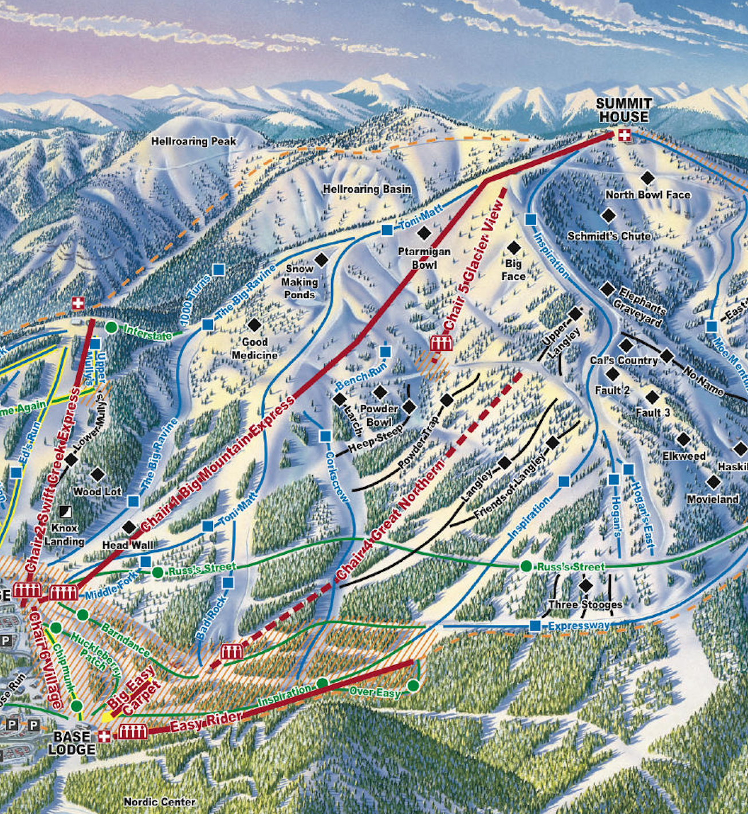
Big Mountain Resort features
Big Mountain Resort offers spectacular views of Glacier National Park and Flathead National Forest, with access to 105 trails.
Every year about 350,000 people ski or snowboard at Big Mountain.
This mountain can accommodate skiers and riders of all levels and abilities.
These are serviced by 11 lifts, 2 T-bars, and 1 magic carpet for novice skiers.
The longest run is named Hellfire and is 3.3 miles in length.
The base elevation is 4,464 ft, and the summit is 6,817 ft with a vertical drop of 2,353 ft.

Slide 3
Problem identification
Problem statement:
What opportunities does Big Mountain resort has regarding ticket price strategy in order to cover operational costs increase by $1,540,000 this season?
Big Mountain Resort has recently installed an additional chair lift to help increase the distribution of visitors across the mountain. This additional chair increases their operating costs by $1,540,000 this season.
Pricing strategy has been to charge a premium above the average price of resorts in its market segment. It does not provide the business with a good sense of how important some facilities are compared to others and doesn’t include any investment strategies options.

Slide 4
Recommendation and key findings
Ticket price change
Big Mountain resort has a possibility to increase ticket price from $81 to $95.47 (with mean absolute error of $10.39)
Facilities change scenarios:
Scenario 1: Reduce number of runs
Closure of 1 least used run won’t influence on ticket price
Further closures are possible with additional loss in ticket price and revenue
Scenario 2: Add 1 run, increase vertical drop for 150 feet and install chair lift
Ticket price could be increased by $1.99
Additional revenue of $3,474,638 will cover new chairlift operational costs of $1,540,000

Slide 5
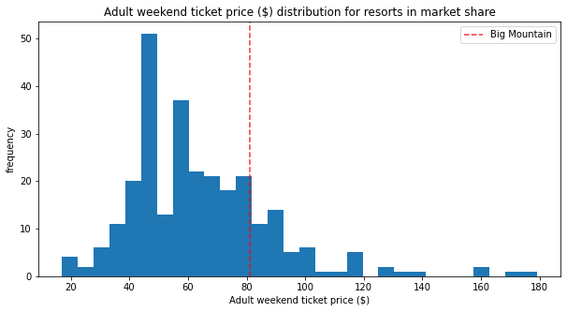
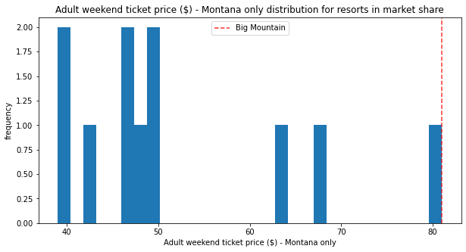
Modeling results and analysis
Ticket price of Big Mountain resort across US and Montana state only
Big Mountain resort is priced high above among similar resorts across US and as top resort in Montana.

Slide 6
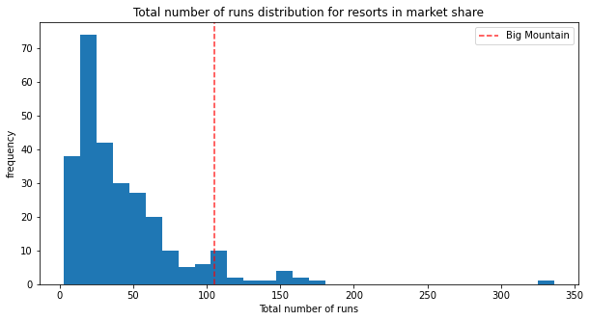
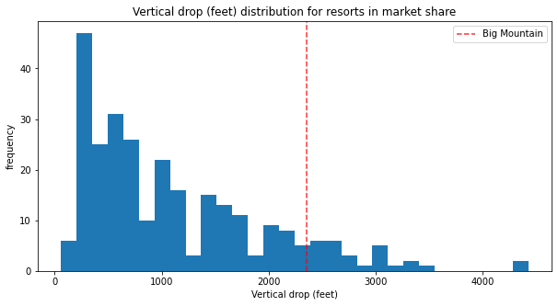
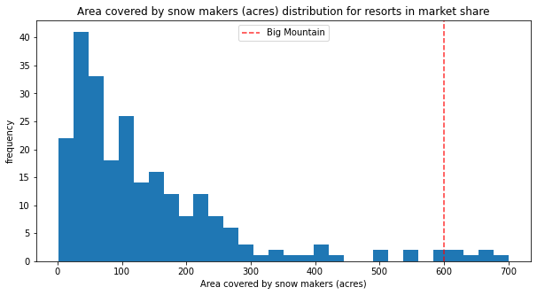
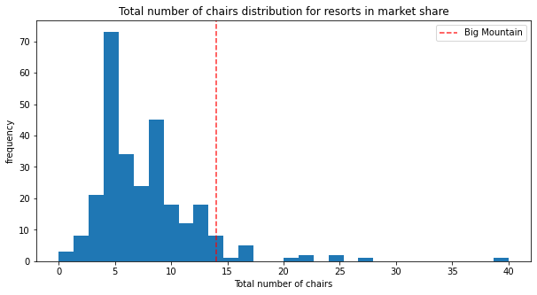
Modeling results and analysis
Main features defined by modeling for Big Mountain resort
Big Mountain resort ranks high above the average market in every shown category and clearly can be defined as premium segment.

Slide 7
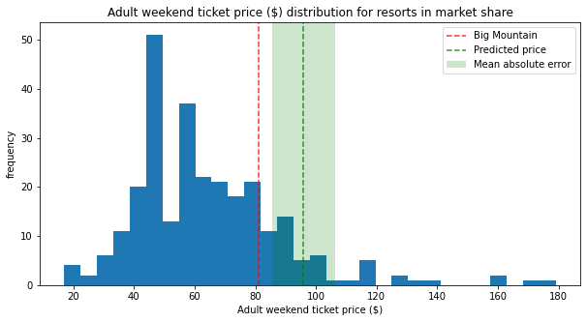
Modeling results and analysis
Price prediction model
Random forest was selected Big Mountain resort price prediction
Predicted price is $95.47
Mean absolute error is $10.39
The main contributing features:
Number of runs, Vertical drop, Area covers by snow making and number of fast quads.

Slide 8
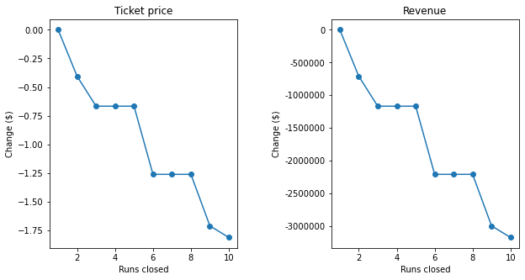
Modeling results and analysis
Scenario 1: Reduce number of runs
Removal of 1 run won’t change ticket price but can be efficient for cost cut.
Closing 2 and 3 successively reduces support for ticket price and so revenue.
If decision will be made to close 3 runs then company can close 4 or 5 runs as ticket price will stay the same as with only 3 runs closure.
Further closures could lead to additional large drop in ticket price.
Scenario 2: Additional run, increased vertical drop for 150 feet and new chair lift:
This scenario increases support for ticket price by $1.99.
Over the season, this could be expected to amount to $3,474,638

Slide 9
Conclusion
Ticket price model shouldn’t be based on average by segment as there is a room for price increase based on facilities available.
There are opportunities for facilities operations investment strategies based on built model as for closing least used run and so for creating additional one with increased vertical drop plus new chairlift for its service.
Further strategies and scenarios can be investigated with additional data for operational costs for existing runs and snow covering.

